Slide 1

Python 3.11 From TimSort to PowerSort
~Zakir Elaskar
Notes:
Good Afternoon Everyone,
My Name is Zakir Elaskar, and my presentation topic is Python 3.11: From TimSort to PowerSort.
So like why python ditched timsort after using it for such a long time

Slide 2
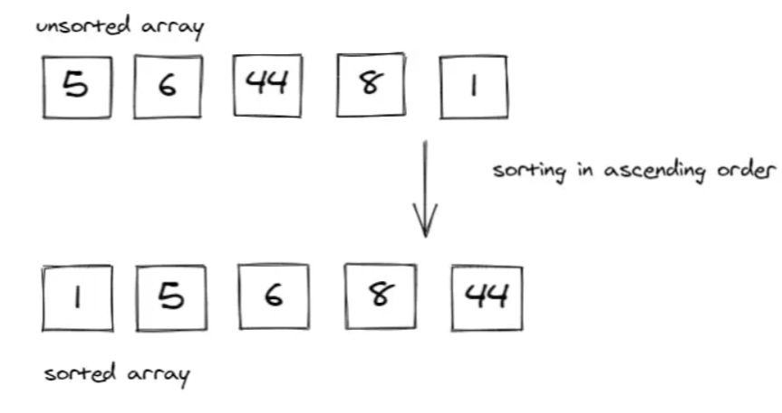
Introduction
What are sorting algorithms and Why do they matter?
Definition: Sorting algorithms are methods used to reorder the elements of a list or array in a specific order (usually ascending or descending). The goal is to arrange data efficiently and logically so that it can be easily processed, searched, or analyzed. Sorting is one of the fundamental operations in computer science and plays a key role in the performance of various applications.
Sorting algorithms matter because:
Efficiency: Sorted data allows for faster searching, as many search algorithms (e.g., binary search) depend on sorted inputs.
Optimization: Many algorithms, including algorithms in data analysis, require sorted data to work effectively.
Use Cases: Sorting is used in database management, machine learning, search engines, and in various computer applications.
Real-World Applications
Databases: Sorting is key for organizing and indexing data, enhancing search speeds (e.g., SQL queries).
E-Commerce: Sorting displays products by filters like price and rating, improving user experience.
Search Engines: Relevance-based sorting ensures top results are shown first.
Machine Learning: Sorting assists with tasks like data cleaning and feature selection.
Notes:
First we will start with what are sorting algorithms? Like here everyone knows all the sorting algorithms insertion sort, bubble sort, merge sort, etc.
So Sorting algorithms are methods for ordering elements in a list or array (either ascending or descending). They help structure data in a way that makes it easier to process and analyze.
Importance: Sorting is a foundational concept in computer science. It enhances efficiency, making data easier to search, organize, and manipulate.
But why sorting or use of sorting algorithm is necessary?
because:
a sorted data is much easier to use than an unsorted data
Also many data analysis and machine learning algorithms require sorted data to work optimally and provide results quickly.
Real-World Applications:
Databases: Sorting helps index data, improving query performance (e.g., SQL queries).
E-Commerce: Sorting products by parameters like price or rating enhances the user experience.
Search Engines: Relevance-based sorting ensures the most relevant results are prioritized.
Machine Learning: Sorting aids in data cleaning and feature selection, ensuring that algorithms work effectively
Efficiency: Sorted data allows faster searching. For example, binary search requires sorted data to quickly locate items, significantly reducing search time.
Optimization: Many algorithms, especially in data analysis and machine learning, require sorted data to function optimally and provide results quickly.
.

Slide 3
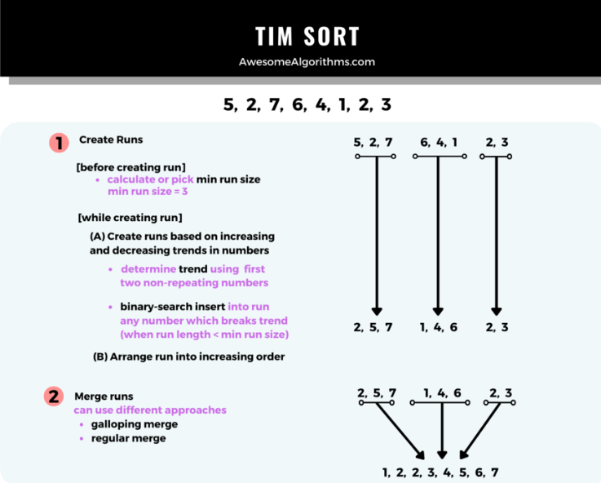
Overview of TimSort
Hybrid Sorting Algorithm: A combination of merge sort and insertion sort, designed for practical applications.
Introduced in Python 2.3: Efficiently handles real-world datasets with natural ordering (partially sorted sequences).
Strengths:
Optimized for partially sorted data.
Stable Sort: Preserves the relative order of equal elements.
Weaknesses:
Edge-Case Performance: Can underperform in certain edge cases.
Extra Space Usage: Requires additional space for merging.
Notes:
Tim sort was introduced in Python 2.3 as the default sorting algorithm
It is a hybrid sorting algorithm that uses Merge Sort and Insertion Sort.
It is specifically designed to handle real-world datasets.
Tim sort works perfectly when it comes to already partially sorted data or has natural ordering, this helps in reducing the overall time complexity.
Also, it is a stable sort meaning it maintains the relative order of two elements with equal values in an array.
The only issue with TimSort is it underperforms in a worst case dataset, that is when the elements are in highly disordered manner or when the dataset is very large.
Also the algorithm additional space for the merge process, which could be a drawback in memory-constrained environments.

Slide 4
Introducing PowerSort
Definition: PowerSort is a next-generation adaptive and stable sorting algorithm, specifically engineered to address limitations in existing sorting methods.
Core Improvement: It builds upon MergeSort, with optimizations tailored to improve performance in the worst-case scenarios, ensuring efficiency even for highly disordered data.
Strengths:
PowerSort is designed to address edge cases (e.g., highly disordered or specific patterns) where TimSort’s performance may degrade.
PowerSort offers more predictable performance across diverse datasets, reducing variability seen in TimSort's performance with certain input distributions.
Notes:
So to avoid all those drawbacks and limitations PowerSort was introduced.
PowerSort is a big step forward in sorting algorithms.
It is built upon MergeSort.
It’s also stable, meaning that if two items are the same, their order will stay the same after sorting.
The main reason PowerSort was introduced is to address the edge cases like worst-case dataset where TimSort fail or degrade over time

Slide 5
TimSort Working
Consider these elements: [5, 7, 8, 4, 2, 1, 3, 10, 12, 11, 9, 15]
Step 1 Identifying Runs:
Run 1: [5,7,8],
Run 2: [4,2,1] → [1,2,4],
Run 3: [10,12],
Run 4: [11,9] → [9,11]]
Run 5: [15]
Step 2 Merging Runs:
Rules for Merging:
Rule 1: X<= Y+ Z is True, Merge X and Y.
If False,
Rule 2: Y <= Z, Merge X and Y
Where,
X is the second to last run
Y is the last run
Z is the third-to-last run
Stack(from bottom to top):
[5, 7, 8] (size 3)
[1, 2, 4] (size 3)
Z = [3, 10, 12] (size 3)
X= [9, 11] (size 2)
Y= [15] (size 1)
The size of the bottom 3 runs are:
X = 2 (Size of [9,11])
Y = 1 (Size of[15])
Z = 3 (Size of [3,10,12])
Rule 1: X(2) < = Y(1) + Z(3) → True
Merge [9,11] and [15]
[9,11,15]
We will get stack as,
[5, 7, 8] (size 3)
[1, 2, 4] (size 3)
[3, 10, 12] (size 3)
[9, 11, 15] (size 3)
Similarly, we will merge, [3,10,12] and [9,11,15], the stack will be:
[5, 7, 8] (size 3)
[1, 2, 4] (size 3)
[3, 9, 10, 11, 12, 15] (size 6)
both merge [3,9,10,11,12] and [1,2,4], the stack will be:
[5, 7, 8] (size 3)
[1, 2, 3, 4, 9, 10, 11, 12, 15] (size 6)
Since, only two runs left, we will merge both.
Final Sort: [1,2,3,4,5,7,8,9,10,11,15]
Notes:
Tim Sort uses a stack (a data structure that works on the Last-In-First-Out principle) to keep track of the runs. Each run is pushed onto the stack as it is identified. Runs on the stack are merged according to specific merging rules.
Short Run: The minimum run length in Tim Sort is 32. So if there are elements less than 32 in a run then that run is known as short run.

Slide 6
PowerSort Working
Consider these elements: [5, 7, 8, 4, 2, 1, 3, 10, 12, 11, 9, 15]
Step 1
Identifying Runs:
Run 1: [5,7,8],
Run 2: [4,2,1] → [1,2,4],
Run 3: [10,12],
Run 4: [11,9] → [9,11]
Run 5: [15]
Step 2
Calculate the “Power” of Runs:
Run 1: [5,7,8] —-> size = 3
Run 2: [1,2,4] —-> size = 3
Run 3: [3,10,12] —--> size = 3
Run 4: [9,11,15] —---> size = 3
So here all the runs are of same size we can start merging from 1 itself.
Step 3:
Merge Runs
First Merge
Merge [5,7,8] with [1,2,4]:
[1,2,4,5,7,8]
Now, the Power runs become:
Run 1: [1,2,4,5,7,8] —-> size = 6
Run 2: [3, 10, 12] —-> size = 3
Run 3: [9,11,15] —--> size = 3
The smallest runs are run 2 and 3 so we merge them
[3, 9, 10, 11, 12, 15]
Now, the Power runs become:
Run 1: [1,2,4,5,7,8] —> size=6
Run 2: [3,9,10,11,12,15] —> size=6
Final Sort: [1,2,3,4,5,7,8,9,10,11,12,15]
Notes:
Power sort use a rule where it assigns a high priority to a run that have less element and

Slide 7
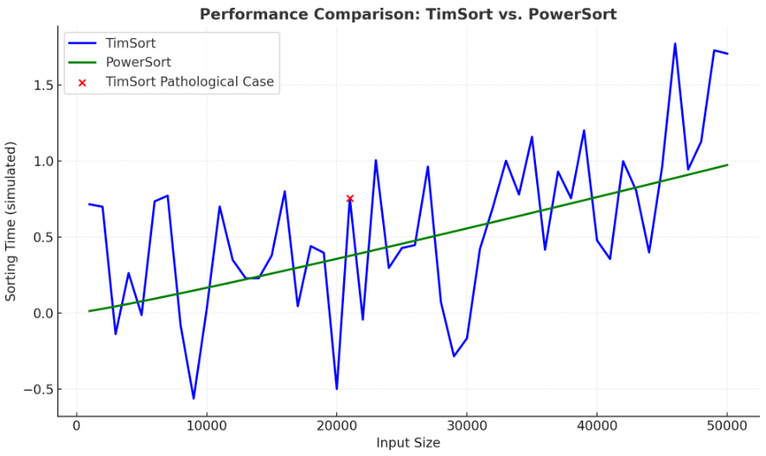
Why Python 3.11 switched to PowerSort
Identified Edge-Case Problems in TimSort:
Issues with "Galloping Mode" causing significant performance drops in specific scenarios.
Unpredictable behavior in datasets with irregular patterns.
PowerSort Advantages:
Tighter bounds for worst-case performance.
Reduced memory allocation overhead.
Enhanced reliability and consistency, aligning with Python’s
performance goals.
Notes:
Okay so why Tim Sort was replaced by PowerSort?
The "Galloping Mode" in TimSort is a technique used to speed up merging when one part of the data is much larger than the other. However, in certain situations, it can cause a big slowdown and hurt performance instead of improving it.
Another problem with TimSort is that its performance can vary depending on the structure of the input data. In cases where the data doesn’t follow a clear or expected pattern (like alternating sorted and unsorted sequences), TimSort can behave unpredictably, leading to inefficiencies that reduce its overall reliability in these scenarios.
PowerSort was designed to perform consistently well even in the worst-case scenarios. Unlike TimSort, which can struggle with certain edge cases, PowerSort guarantees tighter bounds on time complexity, meaning it performs efficiently even when the input data is highly disordered or irregular.
Also in cases where there is huge gaps between elements, or when the dataset is highly disordered, TimSort gives an output which is wrong, like it will skip an element, or it will not know where to place it
Another key improvement in PowerSort is its handling of memory. PowerSort minimizes the need for excessive memory allocations during the sorting process, which reduces overhead and makes it more memory-efficient compared to TimSort. This improvement is especially useful when dealing with large datasets.

Slide 8
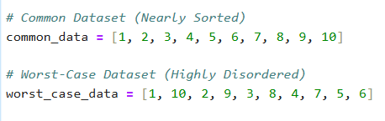
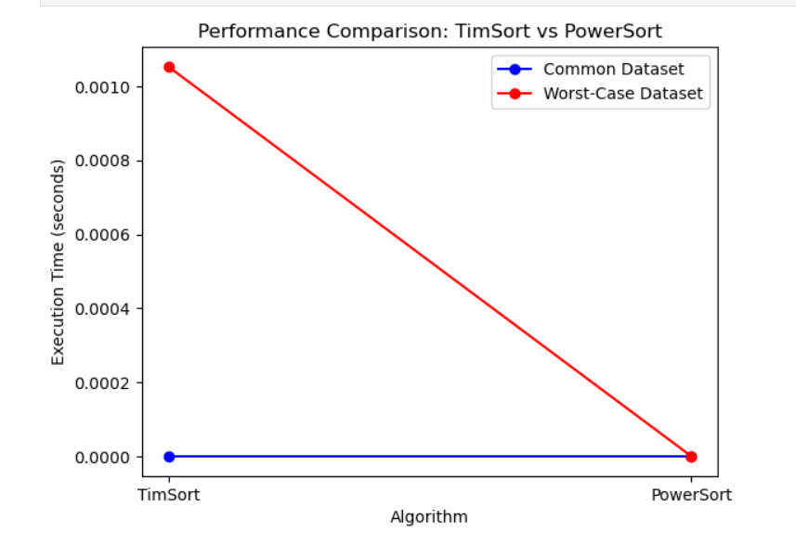
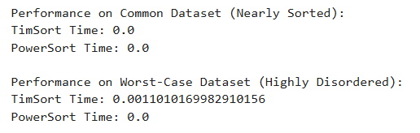
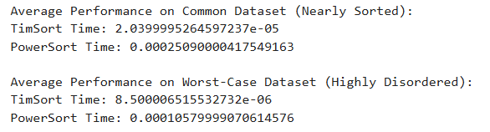
Types of Dataset
Performance on Common and Worst-Case Dataset
Performance Comparison
Average Performance

Slide 9
Conclusion
TimSort is a robust, widely-used sorting algorithm that performs excellently in general-purpose sorting tasks, especially when there are partially ordered elements or runs.
PowerSort holds promise for specific situations where advanced merging techniques can provide better performance, but it is still in the development phase and has not yet reached the level of mainstream adoption.
Notes:
So to conclude we can say TimSort is a well-established algorithm and it is widely used due to its robustness and versatility
Also it excels in general purpose sorting and works well on a partially sorted data and when the dataset is small.
PowerSort is a promising algorithm under development, aimed at specific scenarios where the dataset is large and highly disordered.
While it shows potential, PowerSort has not yet reached the level of mainstream adoption and is still being evaluated for practical applications.
TimSort remains the go-to choice for most sorting needs due to its proven reliability and efficiency. PowerSort, while promising, is in its early stages and may find its niche in specialized use cases as it matures.

